Slide 1
2024
SPONSORSHIP
OPPORTUNITIES
EAST COAST CONNECTION
APRIL 30-MAY 2, 2024 NEW JERSEY

Slide 2
OUR EVENT OFFERS:
A venue where you can connect with a wide range of life sciences suppliers in an intimate setting, alongside prominent pharma, biotech and healthcare corporations
Access relevant learning opportunities aimed at business growth
Superb, inspiring, and relevant keynote speakers
Innovative, hands-on workshops. Speakers covering topics exclusively dedicated to life sciences
Welcoming atmosphere & developing relationships
Celebrate contract wins and share Success Stories, a distinctive feature at our events
Comradery – a place to learn, and grow, together
Energizing conferences with content relevant to every role
Engage & meet with industry thought-leaders and mentors through collaborative opportunities
Exclusive Members Only Day, which includes a Networking Reception
Experience the renowned, unique, highly-affective networking and relationship-building atmosphere DA4S is known for.
The only conference where networking is done effectively in both traditional and social ways
Fabulous Dinner & Networking Reception for all attendees
Highly effective advertising opportunities
Insights into emerging industry trends
Join forces with Supplier Diversity representatives and others during our events
Network with established Suppliers and Buyers in the life sciences
Networking for small and/or diverse businesses to learn from others about best practices (and successes) in an informational and noncompetitive environment
Opportunity to celebrate and strengthen mentor/mentee relationships, old and new alike
Supplier Discovery – meet new supplier members and learn about their capabilities
Supplier Innovation – reconnect with supplier members and learn about their latest innovations
Meet & Greet Networking Roundtables for meaningful interactions
The ‘intimate’ size of our events where all companies are in the life sciences. A one-stop shop
OUR EVENTS
SELL OUT EVERY YEAR!
THE BEST LIFE SCIENCES EVENT TO ATTEND!
LIMITED SPONSORSHIP OPPORTUNITIES AVAILABLE!
Contact dee@DiversityAllianceForScience.com to secure a sponsorship package.
OUR PURPOSE AND MISSION IS CLEARLY a WIN WIN!
Diversity Alliance for Science, Inc. is a non-profit 501(c)(3) organization aimed to provide a platform to identify, attract, and develop small and/or diverse businesses to drive inclusive procurement practices in corporate, academic, and governmental entities within the life science and healthcare industries.

Slide 3
TICKET PRICES • EAST
MEMBER PRICING:
EARLY BIRD BEFORE MARCH 1 $1,325 P/P
_______________________________________________
REGULAR STARTING MARCH 2 $1,400 P/P
NON-MEMBER PRICING:
REGULAR $1,500 P/P
________________________________________________
ACADEMIA / GOV’T / NONPROFIT $800 P/P
_______________________________________________
ADDITIONAL TICKETS FOR SPONSORS: $800 P/P
NO ONSITE REGISTRATIONS.
East Coast Cancellation Policy
• Ticket sales are final. No Refunds once purchased.
• No cancellations or refunds on Sponsorship Packages.
• Names for badges must be submitted no later than April 8.
• Name badge change fee $25 (7 days prior to conference).

Slide 4
EAST COAST CORPORATE SPONSORSHIPS
PLATINUM $15,000
DIAMOND $10,000
GOLD $7,500
SILVER $5,500
Five (5) Full Conference Passes
One (1) reserved table in Sponsor’s name at Conference
One (1) Roundtable during the Roundtable Session
Special Signage recognition during breakfast and/or lunch
Sponsorship recognition on our website & social media with display of logo
Retractable company banner can be displayed throughout the event*
List of Conference Attendees**
Four (4) Full Conference Passes
One (1) reserved table in sponsor’s name at conference
One (1) Roundtable during the Roundtable Session
Sponsorship recognition on our website & social media with display of logo
Retractable company banner can be displayed throughout the event*
List of Conference Attendees**
Three (3) Full Conference Passes
One (1) Roundtable during the Roundtable Session
Sponsorship recognition on our website & social media with display of logo
Retractable company banner can be displayed throughout the event*
Two (2) Full Conference Passes
One (1) Roundtable during the Roundtable Session
Sponsorship recognition on our website & social media with display of logo
Retractable company banner can be displayed throughout the event*
* Sponsor responsible for providing, setting up & removing their banner.
** Attendee list is shared post conference. Email addresses are not included.

Slide 5
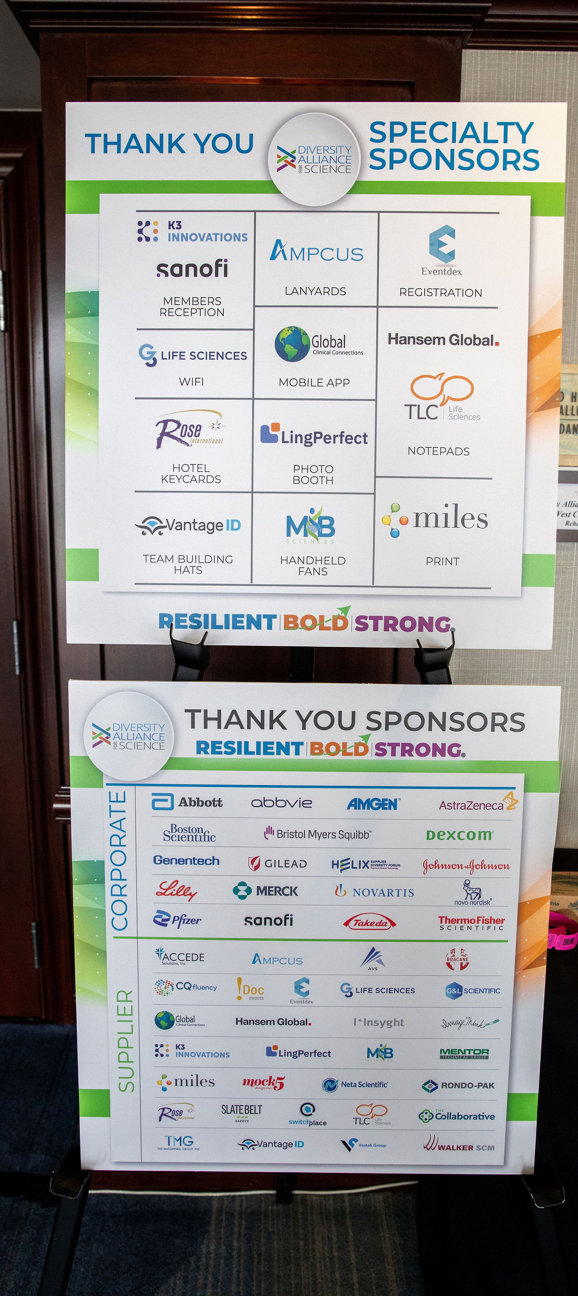
EAST COAST SUPPLIER SPONSORSHIPS
PLATINUM $7,500
DIAMOND $5,000
GOLD $3,500
Three (3) Full Conference Passes
One Hour Virtual Meeting with Available Corporate Company
Special Signage Recognition at Refreshment Breaks
Sponsorship recognition on our website & social media with display of logo
Retractable company banner can be displayed throughout the event*
List of Conference Attendees**
Two (2) Full Conference Passes
Signage Recognition during Luncheon
Sponsorship recognition on our website & social media with display of logo
Retractable company banner can be displayed throughout the event*
One (1) Full Conference Pass
Sponsorship recognition on our website & social media with display of logo
Retractable company banner can be displayed throughout the event*
* Sponsor responsible for providing, setting up & removing their banner.
** Attendee list is shared post conference. Email addresses are not included.

Slide 6
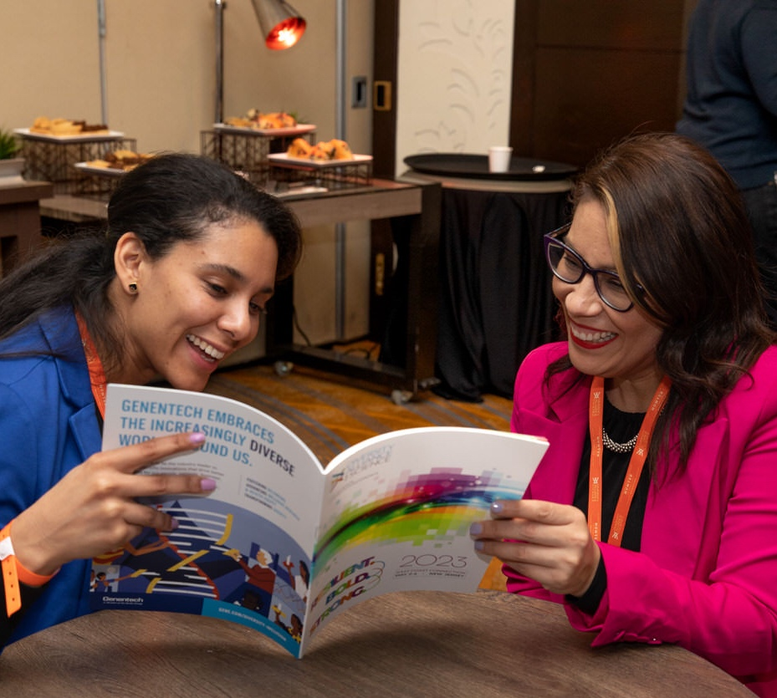
SPECIALTY SPONSORSHIP OPTIONS
DINNER RECEPTION
PHOTO BOOTH
EVENT PROGRAM
COFFEE LOUNGE
2 AVAILABLE • $7,000
Sponsor 150 Drink Tickets at the Wednesday Evening Dinner
Two (2) Full Conference Passes
Retractable company banner can be displayed throughout the event*
1 AVAILABLE • $6,500
Two (2) Full Conference Passes
Supply a Promotional Marketing Item for all Attendees (must get prior approval on items from DA4S)
Retractable company banner can be displayed throughout the event*
1 AVAILABLE • $6,500
Two (2) Full Conference Passes
Sponsor print recognition of conference program booklet
Promotional Marketing Item for all attendees (must get prior approval on items from DA4S)
Retractable company banner can be displayed throughout the event*
2 AVAILABLE • $6,000
Two (2) FULL Conference Passes
Sponsorship recognition on our website & social media with display of logo
Sponsor/s can place marketing materials inside coffee lounge (must get prior approval on items from DA4S)
Retractable company banner can be displayed throughout the event*
* Sponsor responsible for providing, setting up & removing their banner.

Slide 7
SPECIALTY SPONSORSHIP OPTIONS
HOTEL KEY CARDS
MOBILE APP
WI-FI
BADGE LANYARDS
1 AVAILABLE • $5,500
Company AD on one side of all Guests Room Key**
Two (2) FULL Conference Passes
Sponsorship recognition on our website & social media with display of logo
Retractable company banner can be displayed throughout the event*
1 AVAILABLE • $5,000
Banner AD on Mobile Event App
Two (2) FULL Conference Passes
Sponsorship recognition on our website & social media with display of logo
Retractable company banner can be displayed throughout the event*
1 AVAILABLE • $5,000
Sponsor Recognition During Conference with your Brand Specific Wi-Fi Passcode
Two (2) FULL Conference Passes
Sponsorship recognition on our website & social media with display of logo
Retractable company banner can be displayed throughout the event*
1 AVAILABLE • $4,500
Two (2) FULL Conference Passes
Sponsorship recognition on our website & social media with display of logo
Retractable company banner can be displayed throughout the event*
* Sponsor responsible for providing, setting up & removing their banner.
** Sponsor to provide artwork based on DA4S specs

Slide 8
SPECIALTY SPONSORSHIP OPTIONS
MORNING JUICE BAR
TABLE NOTE PADS
2 AVAILABLE • $4,500
Smoothie Juice Bar Sponsor for Morning Beverages
One (1) FULL Conference Pass
Sponsorship recognition on our website & social media with display of logo
Retractable company banner can be displayed throughout the event*
2 AVAILABLE • $4,000
Notepads to be Placed on Main Ballroom Tables. Sponsor to Provide Notepads
Two (2) FULL Conference Passes
Sponsorship recognition on our website & social media with display of logo
Retractable company banner can be displayed throughout the event*
* Sponsor responsible for providing, setting up & removing their banner.

Slide 9
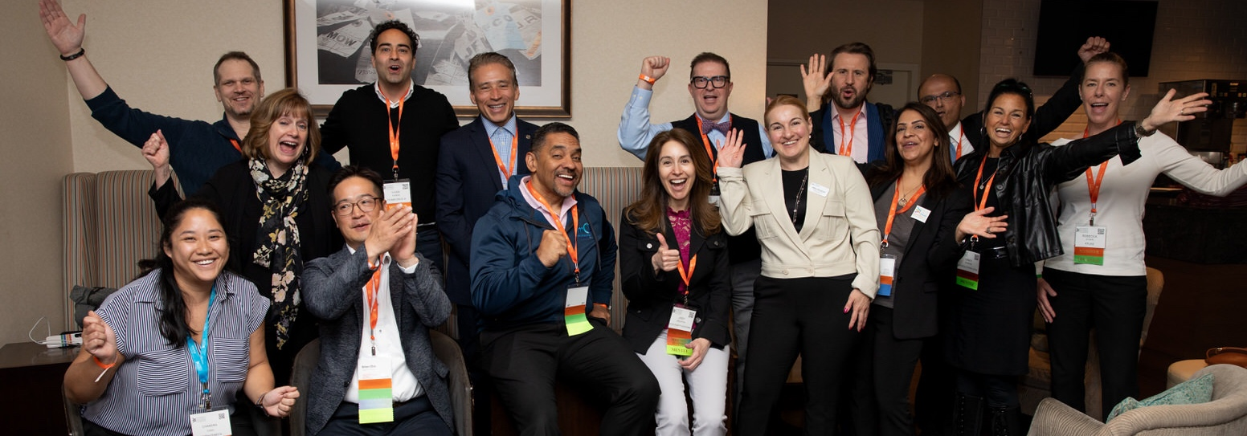
GOT QUESTIONS?
Visit: DiversityAllianceForScience.com
Contact: Dee@DiversityAllianceForScience.com

