Slide 1
EAST COAST
CONNECTION
2025
SPONSORSHIP
OPPORTUNITIES
APRIL 29 - MAY 1, 2025 NEW JERSEY

Slide 2
OUR EVENT OFFERS:
THE BEST LIFE SCIENCES EVENT TO ATTEND!
A venue where you can connect with a wide range of Life Sciences suppliers in an intimate setting alongside prominent pharma, biotech and healthcare corporations
Access relevant learning opportunities aimed at business growth
Superb, inspiring, and relevant keynote speakers
Innovative, hands-on workshops
Speakers covering topics exclusively dedicated to Life Sciences
Welcoming atmosphere & developing relationships
Celebrate contract wins & share Success Stories, a distinctive feature at our events
Comradery – a place to learn & grow, together
Energizing conferences with content-relevant to every role
Engage & meet with industry thought leaders and mentors through collaborative opportunities
Exclusive Members Only Day, which includes a Networking Reception
Experience the renowned, unique, highly effective networking & relationship-building atmosphere DA4S is known for
The only conference where networking is done effectively in both traditional & social ways
Fabulous Dinner & Networking Reception for all attendees
Highly effective advertising opportunities
Insights into emerging industry trends
Join forces with Supplier Diversity representatives & others during our events
Network with established Suppliers & Buyers in the Life Sciences
Networking for small and/or diverse businesses to learn from others about best practices (and successes) in an informational & noncompetitive environment
Opportunity to celebrate & strengthen mentor/mentee relationships, old and new alike
Supplier Discovery – meet new supplier members & learn about their capabilities
Supplier Innovation – reconnect with supplier members & learn about their latest innovations
Meet & Greet Networking Roundtables for meaningful interactions
An ‘intimate’ sized event where all companies are in the Life Sciences
A one-stop shop
LIMITED SPONSORSHIP OPPORTUNITIES AVAILABLE!
Contact dee@DiversityAllianceForScience.com to secure a sponsorship package.
OUR PURPOSE AND MISSION IS CLEARLY A WIN WIN!
Diversity Alliance for Science, Inc. is a non-profit 501(c)(3) organization.

Slide 3
TICKET PRICES • EAST COAST
MEMBER PRICING:
EARLY BIRD BEFORE MARCH 3 $1,400 P/P
_______________________________________________
REGULAR PRICING / MARCH 4 $1,500 P/P
NON-MEMBER PRICING:
REGULAR PRICING $1,600 P/P
________________________________________________
ACADEMIA / GOV’T / NONPROFIT $800 P/P
_______________________________________________
ADDITIONAL TICKETS FOR SPONSORS: $800 P/P (Ticket holder must be from sponsoring company)
NO ONSITE REGISTRATIONS.
Cancellation Policy
• Ticket sales are final. No Refunds once purchased.
• No cancellations, refunds, or transfers to other events on Sponsorship Packages.
• Names for badges must be submitted no later than April 8. AFTER April 8 – Name badge change fee $50.

Slide 4
EAST COAST CORPORATE SPONSORSHIPS
CORPORATE
CORPORATE
CORPORATE
CORPORATE
PLATINUM $15,000
DIAMOND $10,000
GOLD $7,500
SILVER $5,500
Four (4) Full Conference Passes
One (1) Reserved Table in Sponsor’s Name at Conference
One (1) Roundtable During the Roundtable Session
Special Signage Recognition During Breakfast
Sponsorship Recognition on our Website & Social Media with Display of Logo
Retractable Company Banner Displayed At The Event*
List of Conference Attendees**
Three (3) Full Conference Passes
One (1) Reserved Table in Sponsor’s Name at Conference
One (1) Roundtable During the Roundtable Session
Sponsorship Recognition on our Website & Social Media with Display Of Logo
Retractable Company Banner Displayed at the Event*
List of Conference Attendees**
Two (2) Full Conference Passes
One (1) Reserved Table in Sponsor’s Name at Conference
One (1) Roundtable During the Roundtable Session
Sponsorship Recognition on our Website & Social Media with Display of Logo
Retractable Company Banner Displayed at the Event*
One (1) Full Conference Pass
One (1) Roundtable During the Roundtable Session
Sponsorship Recognition on our Website & Social Media with Display Of Logo
Retractable Company Banner Displayed at the Event*
* Sponsor responsible for providing, setting up & removing their banner.
** Attendee list is shared post conference. Email addresses are not included.

Slide 5
EAST COAST SUPPLIER SPONSORSHIPS
SUPPLIER
SUPPLIER
SUPPLIER
SUPPLIER
TRAILBLAZER $7,500
FRONTRUNNER $6,500
INNOVATOR $5,500
PIONEER $3,700
Three (3) Full Conference Passes
One Hour Virtual Meeting with Available Corporate Company
Signage Recognition at Refreshment Breaks
Sponsorship Recognition on our Website & Social Media with Display Of Logo
Retractable Company Banner Displayed at the Event*
List of Conference Attendees**
Three (3) Full Conference Passes
Signage Recognition During Luncheon
Sponsorship Recognition on our Website & Social Media with Display Of Logo
Retractable Company Banner Displayed at the Event*
Two (2) Full Conference Passes
Signage Recognition During Luncheon
Sponsorship Recognition on our Website & Social Media with Display Of Logo
Retractable Company Banner Displayed at the Event*
One (1) Full Conference Pass
Sponsorship Recognition on our Website & Social Media with Display Of Logo
Retractable Company Banner Displayed at the Event*
* Sponsor responsible for providing, setting up & removing their banner.
** Attendee list is shared post conference. Email addresses are not included.

Slide 6
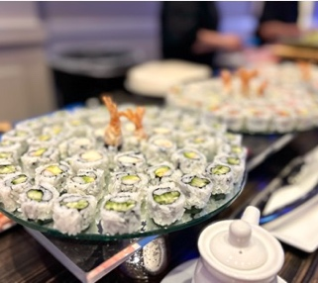
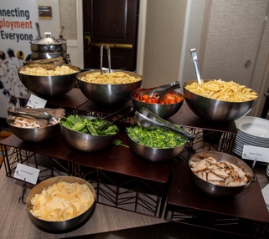
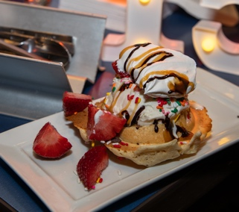
SPECIALTY SPONSORSHIP OPTIONS – WEDNESDAY NIGHT
NETWORKING DINNER
DRINK TICKETS
ENTERTAINMENT
FOOD STATIONS
PHOTO BOOTH
2 AVAILABLE • $8,000
Sponsor 100 Drink Tickets at the Wednesday Networking (Addt’l tickets available at addt’l cost)
Two (2) Full Conference Passes
Sponsor Signage at Dinner
Sponsorship Recognition on our Website & Social Media with Display of Logo
Retractable Company Banner Displayed at the Event*
1 AVAILABLE • $6,000
Two (2) Full Conference Passes
Sponsor Signage at Dinner
Supply a Promotional Marketing Item for Attendees (DA4S must PRE-approve item)
Retractable Company Banner Displayed at the Event*
1 PER STATION • $6,000
SPONSOR YOUR FAVORITE FOOD STATION!
Two (2) Full Conference Passes
Recognition Signage on Food Stations & Tables
Supply a Promotional Marketing Item for Attendees (DA4S must PRE-approve item)
Retractable Company Banner Displayed at the Event*
1 AVAILABLE • $6,000
Two (2) Full Conference Passes
Sponsor Signage at Dinner
Retractable Company Banner Displayed at the Event*
* Sponsor responsible for providing, setting up & removing their banner.

Slide 7
SPECIALTY SPONSORSHIP OPTIONS
MEMBERS RECEPTION
COFFEE LOUNGE
EVENT PROGRAM
DRINK TICKETS
ENTERTAINMENT
2 AVAILABLE • $7,000
Sponsor 100 Drink Tickets at Tuesday Members Reception (Addt’l tickets available at addt’l cost)
Two (2) Full Conference Passes
Sponsor Signage at Reception
Sponsorship Recognition on our Website & Social Media with Display of Logo
Retractable Company Banner Displayed at the Event*
1 AVAILABLE • $6,000
Two (2) Full Conference Passes
Sponsor Signage at Dinner
Supply a Promotional Marketing Item for Attendees (DA4S must PRE-approve item)
Retractable Company Banner Displayed at the Event*
2 AVAILABLE • $6,750
Two (2) Full Conference Passes
Sponsorship Recognition on our Website & Social Media with Display of Logo
Sponsor/s can Place Marketing Materials Inside Coffee Lounge (DA4S must PRE-approve items)
Retractable Company Banner Displayed at the Event*
1 AVAILABLE • $6,000
Two (2) Full Conference Passes
Sponsor Print Recognition of Conference Program Booklet
Promotional Marketing Item for all Attendees (DA4S must PRE-approve items)
Retractable Company Banner Displayed at the Event*
* Sponsor responsible for providing, setting up & removing their banner.

Slide 8
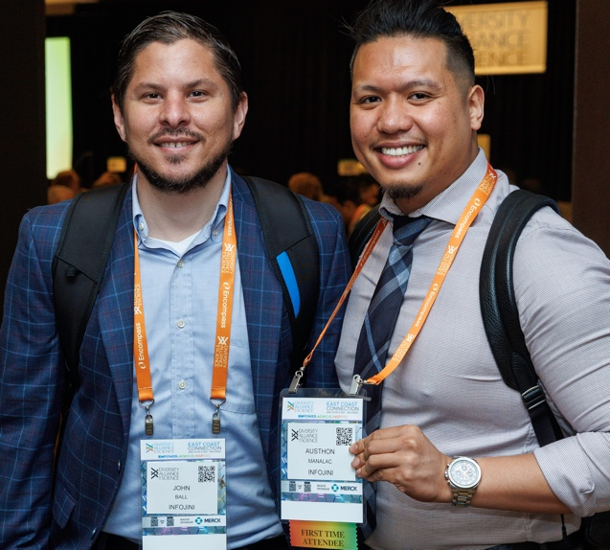
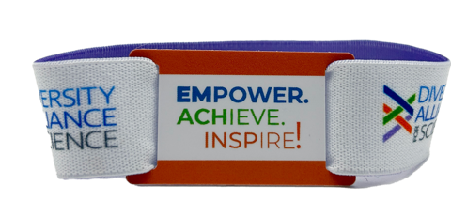
SPECIALTY SPONSORSHIP OPTIONS
HOTEL KEY CARD & WRISTBAND
LANYARDS FOR BADGES
NAME BADGES WITH AGENDA
MOBILE EVENT APP
1 AVAILABLE • $6,000
Company Branding Image on One Side of Card & Logo on Elastic Band**
Two (2) Full Conference Passes
Sponsorship Recognition on our Website & Social Media with Display of Logo
Retractable Company Banner Displayed at the Event*
1 AVAILABLE • $6,000
Two (2) Full Conference Passes
Sponsorship Recognition on our Website & Social Media with Display of Logo
Retractable Company Banner Displayed at the Event*
1 AVAILABLE • $6,000
Company Logo on Conference Badge Holder
Two (2) Full Conference Passes
Sponsorship Recognition on our Website & Social Media with Display of Logo
Retractable Company Banner Displayed at the Event*
1 AVAILABLE • $5,300
Company Name as Access Code & Banner AD on Mobile App
Two (2) Full Conference Passes
Sponsorship Recognition on our Website & Social Media with Display of Logo
Retractable Company Banner Displayed at the Event*
*Sponsor responsible for providing, setting up & removing their banner.
** Sponsor to provide artwork based on DA4S specs.

Slide 9
SPECIALTY SPONSORSHIP OPTIONS
WI-FI
MORNING JUICE BAR
TABLE NOTE PADS
CUSTOMIZED PACKAGE
1 AVAILABLE • $5,000
Company Name as Event Wi-Fi Passcode
Two (2) Full Conference Passes
Sponsorship Recognition on our Website & Social Media with Display of Logo
Retractable Company Banner Displayed at the Event*
2 AVAILABLE • $4,500
Juice Bar Sponsor for Morning Beverages
One (1) Full Conference Pass
Sponsorship Recognition on our Website & Social Media with Display of Logo
Retractable Company Banner Displayed at the Event*
1 AVAILABLE • $4,000
Notepads Placed on Main Ballroom Tables Sponsor to Provide Notepads
One (1) Full Conference Pass
Sponsorship Recognition on our Website & Social Media with Display of Logo
Retractable Company Banner Displayed at the Event*
HAVE A SPONSORSHIP IDEA?
Contact us.
We’d love to work with you!
* Sponsor responsible for providing, setting up & removing their banner.

Slide 10
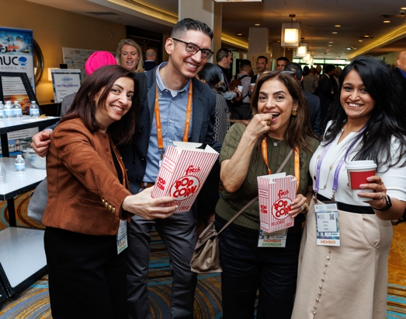
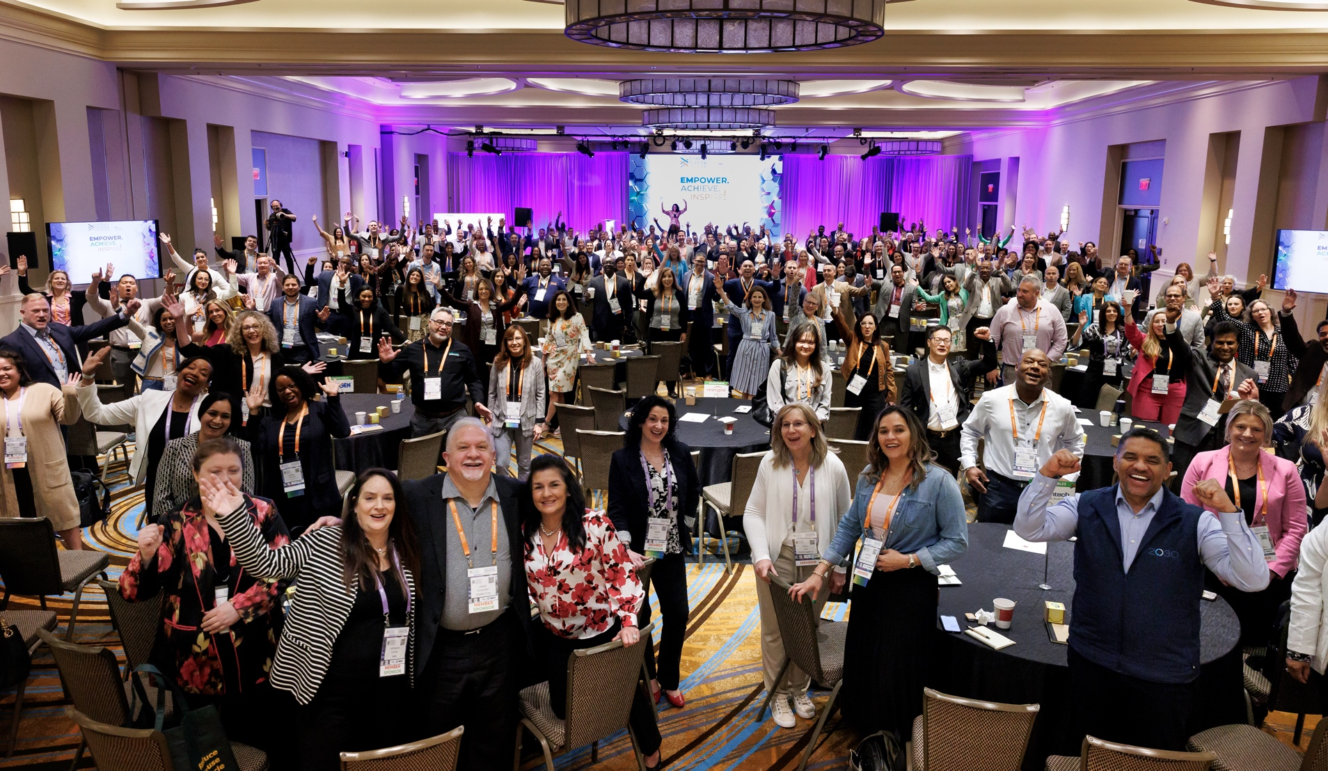
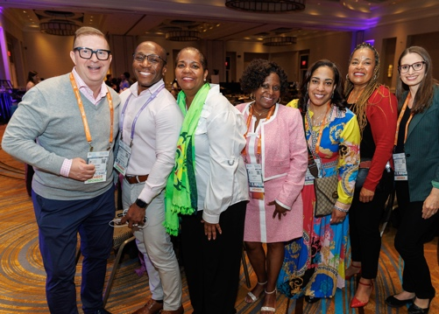
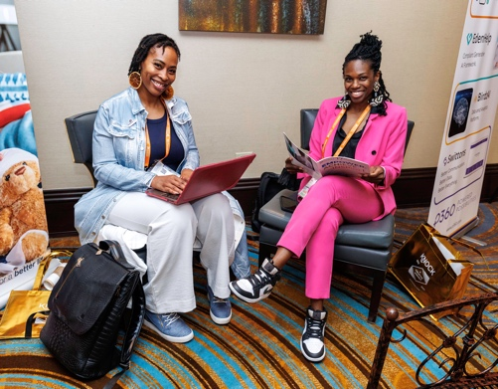
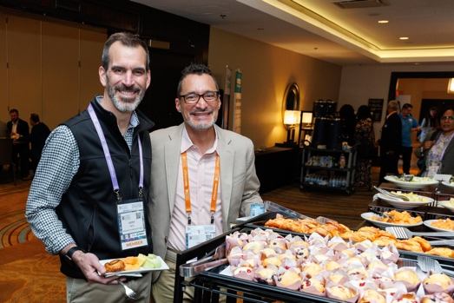
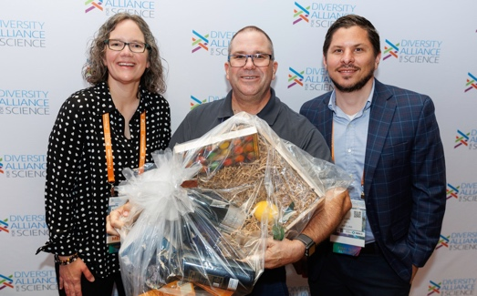
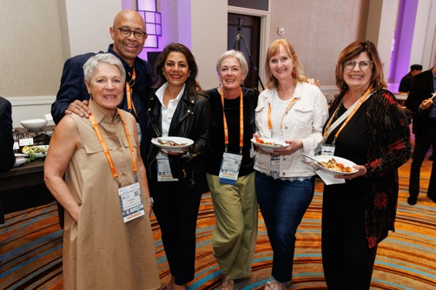
GOT QUESTIONS?
Visit: DiversityAllianceForScience.com
Contact: Dee@DiversityAllianceForScience.com

